Slide 1

Loads and Load Path
"Architecture is inhabited sculpture." -Constantin Brancusi
Civil Engineering and Architecture
© 2010 Project Lead The Way, Inc.

Slide 2
Loads and Load Paths
Structural Design
Design Loads
  Dead Load
  Live Load
  Snow Load
  Lateral Loads
Load Types
Load Combinations
Load Path
Calculating Beam Loads
Notes:
Civil Engineering and Architecture
Unit 3 – Lesson 3.2 - Structures
Project Lead The Way, Inc.
Copyright 2010
Loads and Load Paths

Slide 3
Steps in Structural Design
Planning – How will the building be supported?
Establishing the loads
Designing preliminary structural configuration and layout
Analyzing structural members
Selecting preliminary structural members
Evaluating the preliminary design
Redesigning (if needed) – Repeat the above steps as necessary to achieve a safe and efficient design
Designing and detailing the structural components
Notes:
Structural design is an iterative process.
Planning the structure function for its intended purpose and optimizing the design in terms of cost, material type and weight, and construction time are all part of the planning stage. This stage is completed by both the architect and the structural engineer.
Loads for the structure are determined though the use of building codes.
The preliminary structural configuration is based on the architectural layout and the applied loads.
Analysis of the structure involves estimating the size of the structural members and
calculating the loads the members are required to carry.
Once the structural members have been analyzed, a preliminary selection for each member can be made.
The preliminary member selections should be compared to preliminary assumptions for weight and other design assumptions. Be sure the selected member size and material is compatible with the building design.
Refine the loads and sizes, as necessary, and recalculate and resize structural members.
Finally, design the connections for the structural members and complete the final structural details.
Civil Engineering and Architecture
Unit 3 – Lesson 3.2 - Structures
Project Lead The Way, Inc.
Copyright 2010
Loads and Load Paths

Slide 4
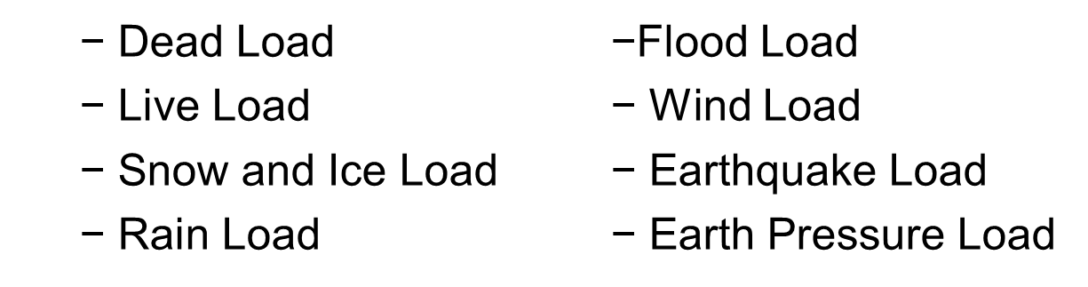
Design Loads
The load that is assumed for the design of a structure
May include one or more of the following:
Notes:
The design load may never occur during the life of a structure, but it is conservative.
Civil Engineering and Architecture
Unit 3 – Lesson 3.2 - Structures
Project Lead The Way, Inc.
Copyright 2010
Loads and Load Paths

Slide 5
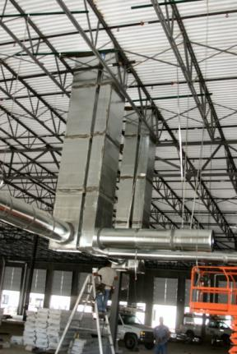
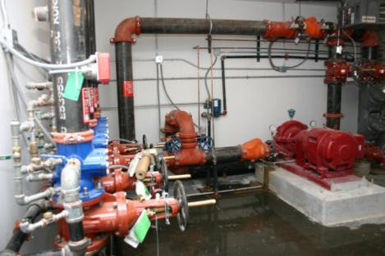
Design Loads
Dead Loads (DL) – fixed loads
    The weight of the building components
    The weight of fixed service equipment
Photos courtesy www.constructionphotographs.com
Notes:
Examples of dead load include
The weight of the roof, walls, floors, and framing
The weight of plumbing, electrical, HVAC, and fire sprinkler systems
The first picture shows HVAC ductwork as well as the roof system and framing – all dead loads
The second picture shows fire suppression equipment
Civil Engineering and Architecture
Unit 3 – Lesson 3.2 - Structures
Project Lead The Way, Inc.
Copyright 2010
Loads and Load Paths

Slide 6


Design Loads
Live Loads (LL) – transient and moving loads
    Loads produced by the use and occupancy of a building
    Live load may be variable during a structure’s lifetime
    Specified in building codes
©iStockphoto.com
©iStockphoto.com
Notes:
Examples of live load include
People, furniture, merchandise, and vehicles
Construction loads
Civil Engineering and Architecture
Unit 3 – Lesson 3.2 - Structures
Project Lead The Way, Inc.
Copyright 2010
Loads and Load Paths

Slide 7

Design Loads
Snow Load
  Force of accumulated snow on a roof
  Specified in building codes (or local building department)
  Depends on
Location
Exposure to wind
Importance of building
Roof slope
©iStockphoto.com
Notes:
Although the weight of snow can be estimated based on typical snowfalls in an area, the magnitude of the design snow load depends on:
Location of the building and amount of snowfall in the area
Exposure of the building to wind
Importance of the building
Slope of the roof
Civil Engineering and Architecture
Unit 3 – Lesson 3.2 - Structures
Project Lead The Way, Inc.
Copyright 2010
Loads and Load Paths

Slide 8
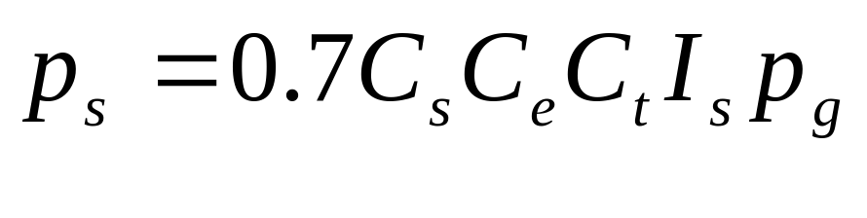
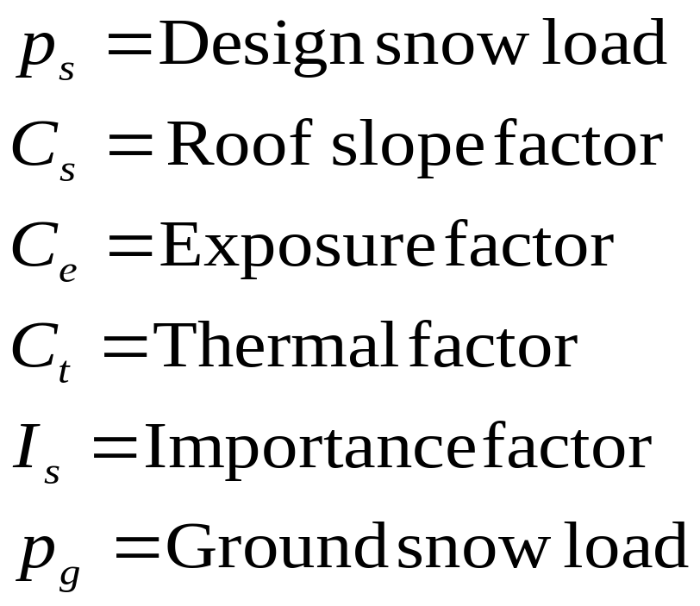
Design Loads
Design Snow Load Calculation
Notes:
The IBC (Section 1608) refers to the ASCE 7 standard for many loading calculations. This formula appears in ASCE 7-05.
Civil Engineering and Architecture
Unit 3 – Lesson 3.2 - Structures
Project Lead The Way, Inc.
Copyright 2010
Loads and Load Paths

Slide 9
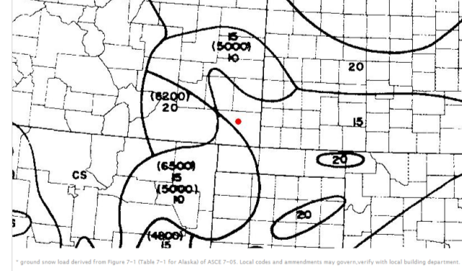




Design Snow Load
Find the ground snow load
For Springfield, CO (red dot) the snow load is 15 psf
Ground Snow Load in psf
Minimum Snow Load
  If , then
  If , then
Notes:
The ground snow load can often be obtained from your local building department or from maps. The IBC provides a ground snow load map (Figure 1608.2) and provides ground snow loads in psf.
This image is part of the Ground Snow Load map found in ASCE 7.
The normal snow load formula takes into consideration multiple average snow events. However, a larger snow load may occur from a single larger snow. The minimum snow loads take into account an unusually heavy event.
Note that other factors should also be considered when determining the snow load, including drifting and the possibility that rain could saturate the snow and make it heavier.
We will not consider these more complicated situations.
Civil Engineering and Architecture
Unit 3 – Lesson 3.2 - Structures
Project Lead The Way, Inc.
Copyright 2010
Loads and Load Paths

Slide 10
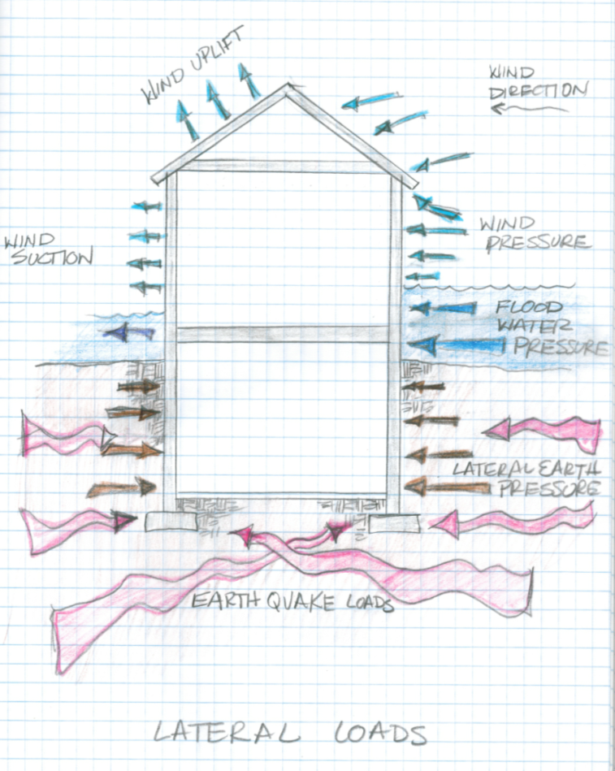
Design Loads
Lateral Loads
  Wind Loads
  Earthquake Loads
  Flood Loads
  Earth Pressure Loads
Notes:
Civil Engineering and Architecture
Unit 3 – Lesson 3.2 - Structures
Project Lead The Way, Inc.
Copyright 2010
Loads and Load Paths

Slide 11
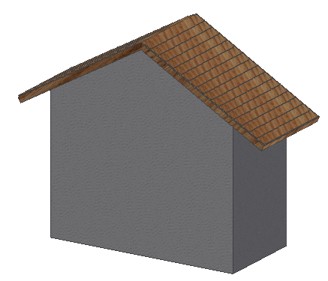
Design Loads
WIND
Wind Load (WL)
Resulting loads yield:
  Lateral load on walls
  Downward and upward pressure on roofs
  Overturning of the structure
Specified in building codes
Pressure
Uplift
Suction
Notes:
Wind loading is another design load that has an impact on the design of the structure.
Wind loads can vary depending on the location and height of structure. These figures are referred to in the Exposure Categories section of building codes.
For low rise buildings, the wind load can be transferred through shear walls , such as a masonry wall in the elevator shaft, and an exterior masonry wall or steel bracing in the structural frame.
Civil Engineering and Architecture
Unit 3 – Lesson 3.2 - Structures
Project Lead The Way, Inc.
Copyright 2010
Loads and Load Paths

Slide 12
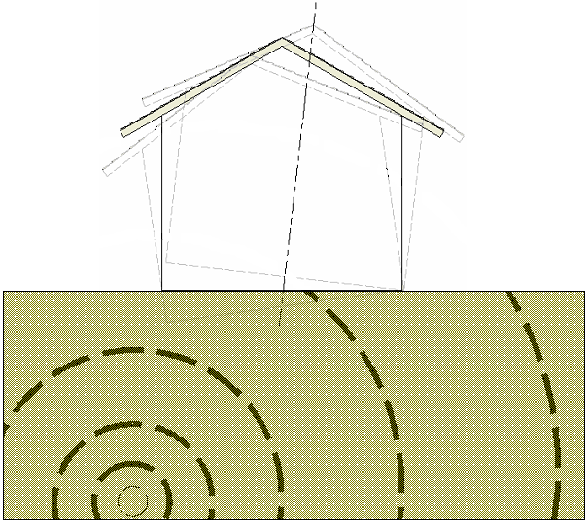
Design Loads
Earthquake Loads (EQ)
  Vertical and lateral forces (dynamic)
  Building codes can simplify loading
Epicenter
Seismic Forces at Base of Building
Hypocenter
Notes:
Earthquake or seismic loads are based on:
The location of the structure
The soil type of the building site
The type of construction and building mass
The shape of the building
Seismic maps depict the potential risks for earthquakes in various areas. Building codes will simply include loading conditions for structures.
Civil Engineering and Architecture
Unit 3 – Lesson 3.2 - Structures
Project Lead The Way, Inc.
Copyright 2010
Loads and Load Paths

Slide 13
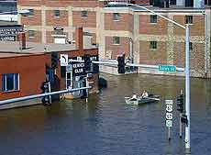
Design Loads
Flood Loads
  Lateral forces resulting from static and dynamic water pressure
  Building codes specify that buildings be constructed above the flood elevation or flood-proofed
    Design requirements dependent on flood zone
Courtesy FEMA
BFE (Base Flood Elevation) – The water surface elevation resulting from a flood with a 1% chance of equaling or exceeding that level in any given year
Dry flood-proofing: Building must be designed and constructed to be watertight to floodwaters
Notes:
We’ll talk about designing for floods in a later lesson, but for now
[click] The flood elevation is often given as the BFE (base flood elevation).
[click] Flood-proofing involved keeping the habitable space dry.
Civil Engineering and Architecture
Unit 3 – Lesson 3.2 - Structures
Project Lead The Way, Inc.
Copyright 2010
Loads and Load Paths

Slide 14
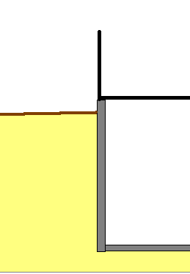
Design Loads
GRADE
Soil Pressure Loads
  Soil adjacent to a structure will apply a lateral force
  Magnitude increases with depth
BASEMENT
SOIL
Notes:
Soil pressure loads depend on the type of soil and the depth of soil adjacent to the structure. More granular soils will apply a higher pressure. As the depth below grade increases, the soil pressure typically increases (similar to water pressure).
Civil Engineering and Architecture
Unit 3 – Lesson 3.2 - Structures
Project Lead The Way, Inc.
Copyright 2010
Loads and Load Paths

Slide 15
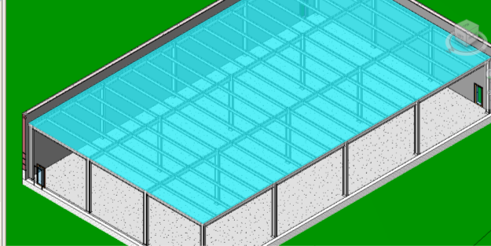
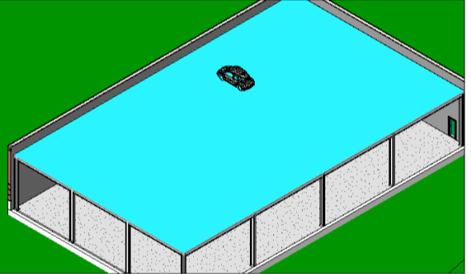
Load Types
Uniformly Distributed Load
Concentrated Load
Notes:
A uniformly distributed load is applied evenly over a large area – like boxes of copy paper stacked from wall to wall in a room.
The dead load of a roof system is uniformly distributed across the entire roof framing system.
Live load is often given as a uniformly distributed load and is assumed to be evenly distributed across the entire area.
A concentrated load is a load that is applied to a small area – like a vertical stack of five copy paper boxes.
The small vehicle on the roof of the building would be considered a concentrated load.
Although the load may actually be distributed over a small area, it is often assumed to be applied at a single point.
Civil Engineering and Architecture
Unit 3 – Lesson 3.2 - Structures
Project Lead The Way, Inc.
Copyright 2010
Loads and Load Paths

Slide 16
Load Combinations
A building will be subjected to many loads simultaneously
Codes specify combinations of loads that must be considered in the design
Examples
  D + L + (L_{r} or S or R)
  D + L + W
  D + L + S + E/1.4
Where D = Dead load
L = Live load
L_{r} = Roof live load
W = Wind load
S = Snow load
E = Earthquake load
R = Rain load
Notes:
Civil Engineering and Architecture
Unit 3 – Lesson 3.2 - Structures
Project Lead The Way, Inc.
Copyright 2010
Loads and Load Paths

Slide 17
Design Loads
  The building dead load is the only known load.
  All other forces will vary in magnitude, duration, and location.
  The building is designed for design load possibilities that may never occur.
Notes:
Civil Engineering and Architecture
Unit 3 – Lesson 3.2 - Structures
Project Lead The Way, Inc.
Copyright 2010
Loads and Load Paths

Slide 18
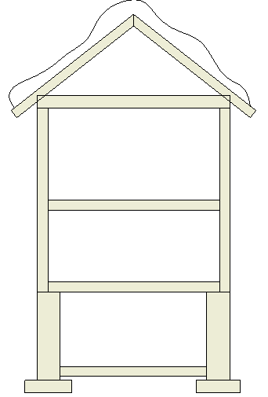


Load Path
The path that a load travels through the structural system
“Tracing” or “chasing” the loads
Each structural element must be designed for all loads that pass through it
HVAC
Notes:
The illustration depicts how loads travel through a building structure. All loads are traced to the foundation.
Civil Engineering and Architecture
Unit 3 – Lesson 3.2 - Structures
Project Lead The Way, Inc.
Copyright 2010
Loads and Load Paths

Slide 19
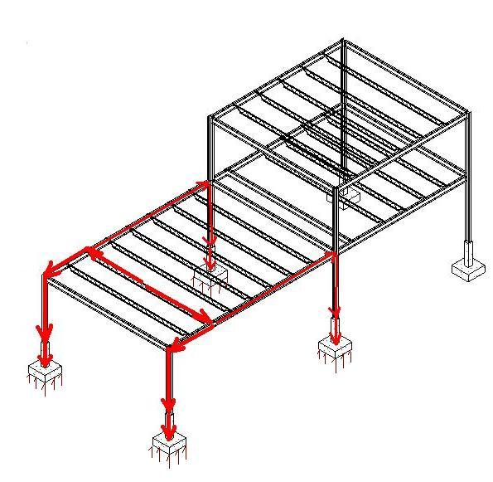
Load Path
Every load applied to the building will travel through the structural system until it is transferred to the supporting soil.
APPLIED LOAD
Notes:
In this structural steel frame, the green applied load travels through the structural system taking four different loads paths (red arrows) simultaneously to finally reach the supporting soil.
Civil Engineering and Architecture
Unit 3 – Lesson 3.2 - Structures
Project Lead The Way, Inc.
Copyright 2010
Loads and Load Paths

Slide 20
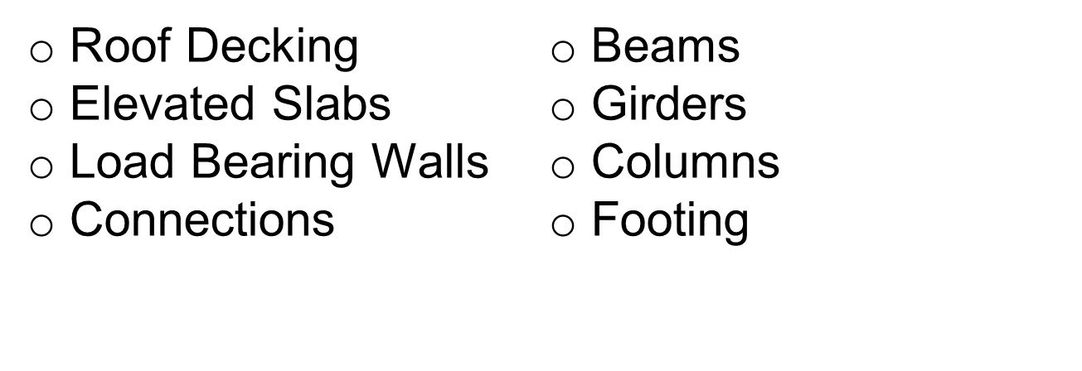
Structural Elements
Within the structural systems, individual structural elements must work together to carry and transfer the applied loads to the ground.
Examples of structural elements include:
Notes:
Each of the structural systems within a structure must be analyzed to determine the loading that it must carry. If the load path of an applied load passes through an element, the structural elements must be designed for that load.
Civil Engineering and Architecture
Unit 3 – Lesson 3.2 - Structures
Project Lead The Way, Inc.
Copyright 2010
Loads and Load Paths

Slide 21
“Load Chasing” for Structural Design
The structural design is performed by “chasing the loads” of the dead and live load from slabs to beams to girders, then on to the columns or walls. The loads are then carried down to the footing or foundation walls and finally to the earth below.
Notes:
Civil Engineering and Architecture
Unit 3 – Lesson 3.2 - Structures
Project Lead The Way, Inc.
Copyright 2010
Loads and Load Paths

Slide 22
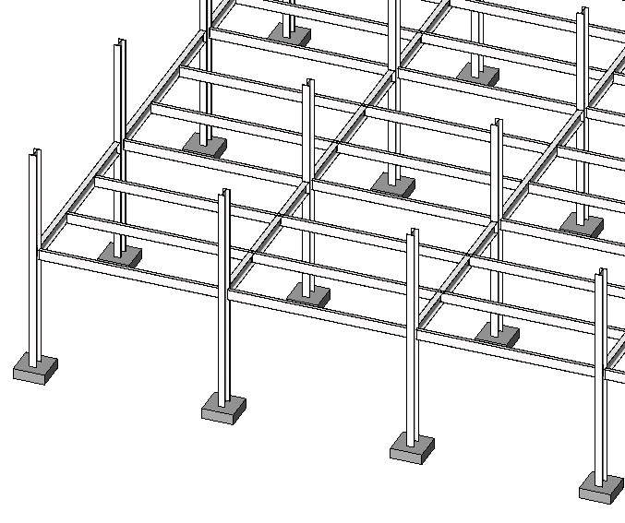
Girder
Beam
Column
Footing
Partial View of 2nd Floor Framing
For clarity the ground floor slab, 2nd floor slab, roof framing, and roof deck are not shown.
Notes:
Isometric view of the proposed structure.
Let’s look at an example of how we would “chase” a uniformly distributed load applied to a floor slab to the beams of a structural steel frame.
Civil Engineering and Architecture
Unit 3 – Lesson 3.2 - Structures
Project Lead The Way, Inc.
Copyright 2010
Loads and Load Paths

Slide 23
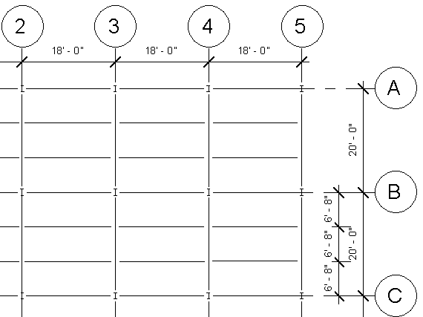
Beam
Design Area
Girder
Partial 2nd FLOOR FRAMING PLAN
Girder
Notes:
Partial 2nd Floor Framing Plan shown. We will examine the Interior Bay Area bounded by Column lines 3 and 4 and B and C. Notice that the beams are 18 feet long and the girders are 20 feet long.
Girders are simply beams that support other beams.
Civil Engineering and Architecture
Unit 3 – Lesson 3.2 - Structures
Project Lead The Way, Inc.
Copyright 2010
Loads and Load Paths

Slide 24
Tributary Area
3’- 4” Half the distance to each adjacent beam
Beam B.3
6’-8” TributaryWidth
Partial 2nd FLOOR FRAMING PLAN
Tributary Area = Beam Span (length) x Tributary Width
Notes:
Each structural member in the framing system carries a certain area of the load. This is known as the tributary area or contributing area.
A beam will typically carry a width of floor (or roof) that is halfway to each adjacent beam.
Here the beams are spaced at 6’-8”; therefore, the beam will carry the floor load for half the distance to each adjacent beam (3’-4”).
You can find the tributary width by adding half the distance to the adjacent beam on both sides. In this case, since the beams are evenly spaced, the tributary width is 3’-4” + 3’-4” = 6’-8”.
The tributary area for this beam is 6’-8” times 18’-0”, which equals 120 ft².
Civil Engineering and Architecture
Unit 3 – Lesson 3.2 - Structures
Project Lead The Way, Inc.
Copyright 2010
Loads and Load Paths

Slide 25
Beam B.3
6'-8'' TributaryWidth
Beam Uniform Load = Floor Loading (psf) x Tributary Width (ft)
Notes:
When designing beams, we are typically interested in the uniform load along the beam. That is, we want to know how much load is applied to each foot of length along the beam. To find the uniform load applied to the beam, determine the product of the floor loading (in pounds per square foot) and the tributary width.
Civil Engineering and Architecture
Unit 3 – Lesson 3.2 - Structures
Project Lead The Way, Inc.
Copyright 2010
Loads and Load Paths

Slide 26
Beam B.3
6'-8'' TributaryWidth
Tributary Area = Beam Span (length) x Tributary Width
Tributary Area = (18 ft) ∙ (6.67 ft) = 120 ft²
Notes:
The tributary area is the floor area supported by the beam. In this case, the tributary area for Beam B.3 is 120 square feet.
When calculating tributary area, be sure to convert lengths in feet and inches to decimal inches. So, 6’-8” is 6.67 feet.
Civil Engineering and Architecture
Unit 3 – Lesson 3.2 - Structures
Project Lead The Way, Inc.
Copyright 2010
Loads and Load Paths

Slide 27
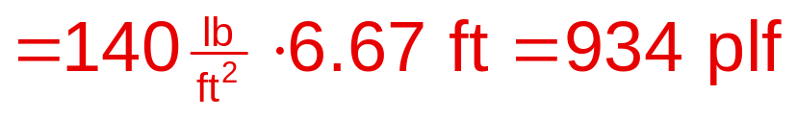
Calculating Beam Loading
Assume that the floor system must support its own weight of 40 psf (dead load) and a live load of 100 psf. What is the uniform load applied to the beam?
Total Floor Load = 40 + 100 = 140psf
Uniform Load = Floor Load ∙ Tributary Width
Notes:
The total floor load is the sum of the dead load and live load.
The uniform load along the beam is 934 pounds per linear foot of beam.
The slab transferred the load to this beam and all other beams in the floor system according to their individual tributary widths.
Civil Engineering and Architecture
Unit 3 – Lesson 3.2 - Structures
Project Lead The Way, Inc.
Copyright 2010
Loads and Load Paths

Slide 28
Calculating Girder Loading
ExteriorGirder
Beam
DESIGN AREA
Interior Girder
Partial 2nd FLOOR FRAMING PLAN
Notes:
Each beam must transfer its load to another structural member. For beams that are on the column lines, the load is transferred directly to the column. For beams that are not on column lines, the load is transferred to a girder.
Therefore, each girder will be loaded by a concentrated load from each beam it supports. If the girder is exterior; that is, if it is located on the outside edge of the structure, it will receive load from beams on only one side. If the girder is interior, it will receive load from beams on both sides.
Civil Engineering and Architecture
Unit 3 – Lesson 3.2 - Structures
Project Lead The Way, Inc.
Copyright 2010
Loads and Load Paths

Slide 29
Calculating Column Loads
Calculating Column Loads
Beam
Girder
Notes:
The beams and girders will then transfer the load to the supporting column. Interior columns, like column B3, will receive load from two girders and two beams. Exterior and corner columns will typically carry less load.
Civil Engineering and Architecture
Unit 3 – Lesson 3.2 - Structures
Project Lead The Way, Inc.
Copyright 2010
Loads and Load Paths

Slide 30


Calculating Column Loads
Tributary Area = (18 ft)(20 ft) = 360 ft²
Notes:
An alternate method of calculating a column load uses the tributary area of the columns. The tributary area is the area of the floor for which column B3 is the closest column. In other words, it is the area within half the distance to the adjacent columns both N-S and E-W.
In this case, the area is (9 ft + 9ft =) 18 ft times (10 ft = 10 ft =) 20 ft or 360 square feet.
Civil Engineering and Architecture
Unit 3 – Lesson 3.2 - Structures
Project Lead The Way, Inc.
Copyright 2010
Loads and Load Paths

Slide 31
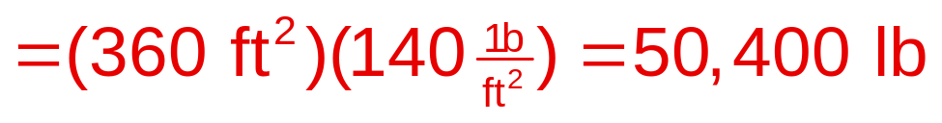
Calculating Column Loads
Assume that the floor system must support its own weight of 40 psf (dead load) and a live load of 100 psf. What is the column load for column B3?
Total Floor Load = 40 + 100 = 140psf
Column Load = Tributary Area ∙ Total Floor Load
Notes:
Find the column load to column B3 from the floor.
Civil Engineering and Architecture
Unit 3 – Lesson 3.2 - Structures
Project Lead The Way, Inc.
Copyright 2010
Loads and Load Paths

Slide 32
Loads and Load Paths
Structural Design
Design Loads
  Dead Load
  Live Load
  Snow Load
  Lateral Loads
Load Types
Load Combinations
Load Path
Calculating Beam Loads
Notes:
Civil Engineering and Architecture
Unit 3 – Lesson 3.2 - Structures
Project Lead The Way, Inc.
Copyright 2010
Loads and Load Paths

Slide 33
Image Sources
iStockphoto.com
www.constructionphotographs.com
Federal Emergency Management Agency
Notes:
Civil Engineering and Architecture
Unit 3 – Lesson 3.2 - Structures
Project Lead The Way, Inc.
Copyright 2010
Loads and Load Paths

Slide 34
Partial Roof FLOOR FRAMING PLAN
Notes:
Print out this slide (handout with 2 slides per page) for students to use in their journal as they take notes for this lesson.
Civil Engineering and Architecture
Unit 3 – Lesson 3.2 - Structures
Project Lead The Way, Inc.
Copyright 2010
Loads and Load Paths

